Slide 1
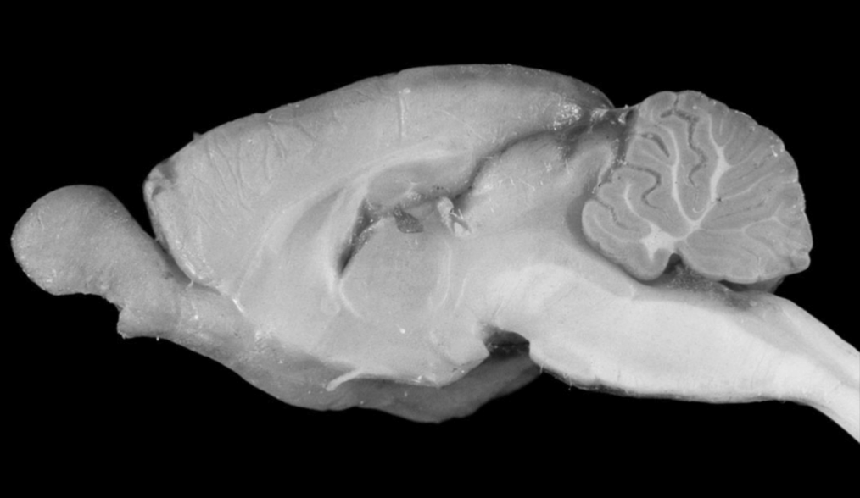

Left Ear
Left Eye
Vision
Hearing
Memory
Touch
Control
Orienting
Action
Selection
Planning
Fixed Action
Patterns
Olfaction
Pattern
Generators
Reflexes
Drives
Right Ear
Right Eye

